Slide 1
PARTICIPANT DAYS
20th till the 24th of August
On the 20th till the 24th of August the psychology department is organizing one week with many behavioral experiments. There will be behavioral, EEG and eye-tracking experiments. Each day, you can participate for up to 3 hours, and you can participate for as many days as you want. All experiments will take place on VU campus in the transitorium
We pay €10 per hour
Two days in a row: bonus of € 15
Five days in a row: bonus of € 50
Participation in all 5 days: € 200
For more information or to sign up
please send an e-mail before the 10th of august to:
c.proefleider@gmail.com

Slide 2
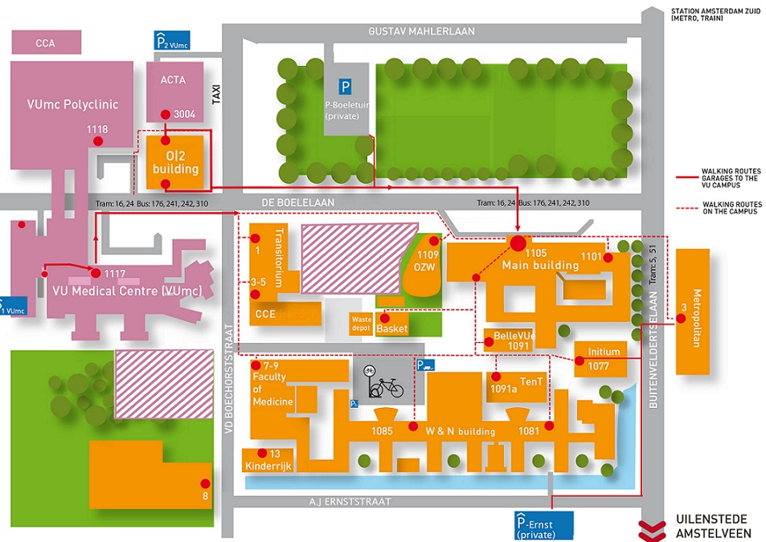
In your e-mail please include the following information:
Name, Date of birth, Gender and Native language. If you have any optical corrections, and which kind (glasses, hard/soft contact lenses),
Your dexterity (right-/ left-handed or both), Whether you have any language disorders (e.g. dyslexia).
Your availability: morning (10:00 – 13:00) or afternoon (14:00 – 17:00) for each day
What kinds of experiments you would rather not perform (e.g., eye-tracking, EEG or behavioral).
Unfortunately, we are not able to test people who are partially or completely colorblind. Furthermore, participants should be between 18 and 35 years old.

